Slide 1
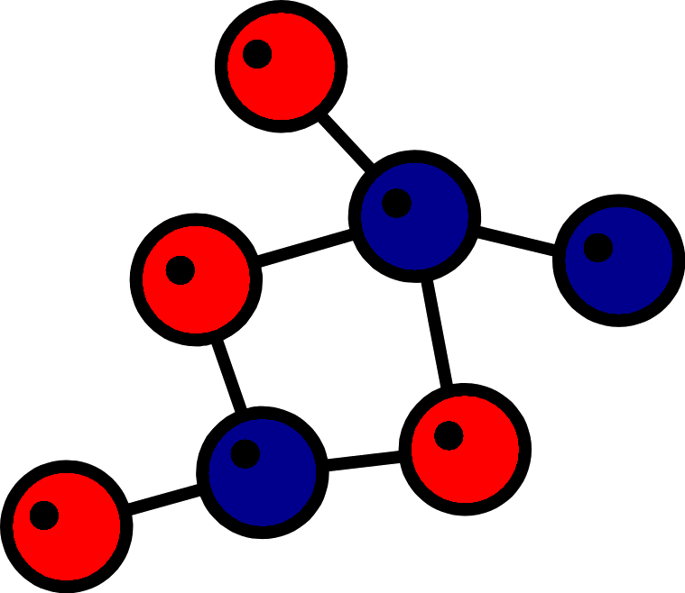
Quantum Number

Slide 2
What is Quantum Number?
Quantum Number is the address of a particular electron in an atom
With the help of Quantum Numbers, you can locate an electron
Certain identification numbers which are necessary to give complete information about any revolving electron in an atom are quantum numbers.

Slide 3
Classification of Quantum Number
There are four quantum numbers used to describe the exact position and the nature of an electron. They are-
Principal quantum number
Azimuthal quantum number
Magnetic quantum number
Spin quantum number

Slide 4
Principal quantum number
Different energy levels in an atom have been represented by n, which can have non-zero positive integer values up to 7 (till now) i.e.
n = 1, 2, 3, 4…7
n can have infinite values and it has been called the Principal quantum number.
It defines the orbit, in which the electron is situated

Slide 5
Azimuthal quantum number
Sommerfeld proposed the existence of elliptical orbits, besides the circular orbits of Bohr.
mass p = mass n = 1840 x mass e⁻

Slide 6
THANK YOU FOR YOUR PATIENCE
HAVE A NICE DAY

